Slide 1
Are my unit tests testing well? Introduction to 'behavior coverage'

Slide 2
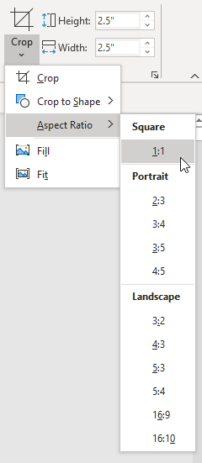
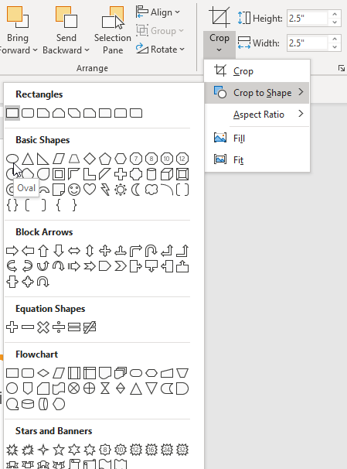
Welcome and Introduction
After inserting the photo onto the slide, click the Format tab at the top.
Click the Crop drop-down > Aspect Ratio > 1:1 to make it a perfect square.
Then go back to the Crop drop-down > Crop to Shape > and pick the Oval shape.
Place speaker’s photo over this area.
See notes on the right on how to crop your photo into a perfect circle.
1.
2.
Konrad Gałczyński
Senior Software Engineer

Slide 3


Relativity creates intuitive software that helps law firms, government agencies, financial institutions, and other major corporations quickly find the truth in data.
Founded in 2001, Relativity is headquartered in Chicago with offices worldwide in New Jersey, London, Krakow, Hong Kong, and Melbourne.
1,200+ employees
300,000+ enabled platform users
5,000+ attendees at Relativity Fest 2020, the largest conference for the e-discovery and compliance communities, and the second largest conference in legal technology
100+ developer partners and 140+ apps developed for the Relativity ecosystem
Relativity is available in 49 countries; RelativityOne is available in 9 countries and growing.

Slide 5
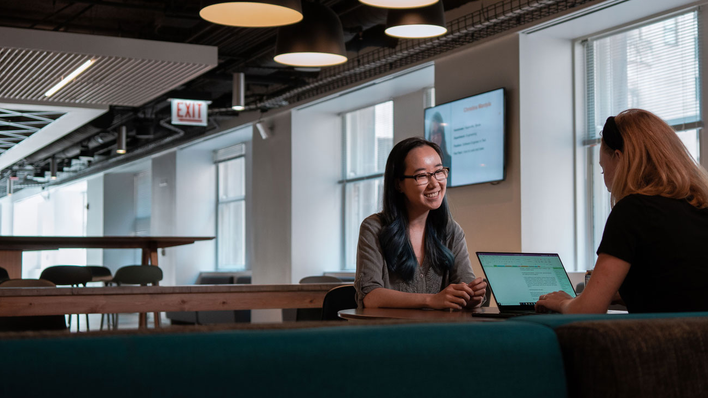
Internships
Students can take on paid, real-world assignments:
Write code
Work on a team of professionals
Gain tailored work experience
Social activities to grow your network
Interns are assigned a mentor to ensure getting the most out of the experience
This year all internships will be remote
Notes:
Interns and apprentices at Relativity aren’t errand-runners. From the moment you step in the door, you’ll play a critical role in our global business.
Relativity hosts immersive internship programs across the company, where college students and recent grads take on real-world assignments. You’ll write code, work on a team of professionals, and gain work experience that’s tailored to you. And yes – you’ll get paid for it, too.

Slide 6
Thank you for attending

Slide 7





Stay connected with us @RelativityHQ

